Slide 1
Fundamental Programming in JAVA
Inheritance

Slide 2
Objectives
To define a subclass from a superclass through inheritance.
To invoke the superclass’s constructors and methods using the super keyword .
To override instance methods in the subclass.
To distinguish differences between overriding and overloading.
To explore the toString() method in the Object class.
To explore the equals method in the Object class.
To enable data and methods in a superclass accessible from subclasses using the protected visibility modifier.
To prevent class extending and method overriding using the final modifier.

Slide 3
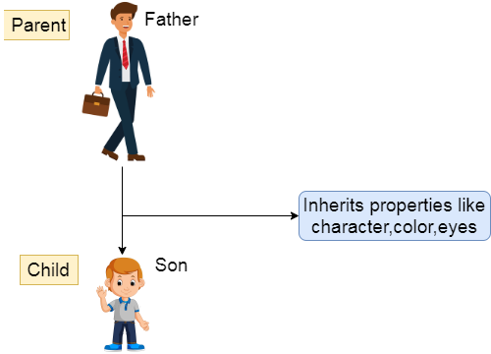
What is inheritance ?
Inheritance in Java is a concept that acquires the properties from one class to other classes. With inheritance, programmers save time during program development by reusing proven and debugged high-quality software. This also increases the likelihood that a system will be implemented effectively.

Slide 4
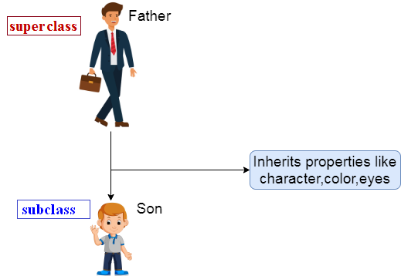
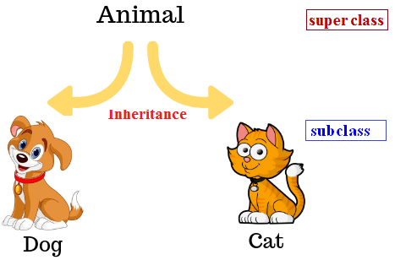
What is inheritance ?
When creating a class, rather than declaring completely new members, you can designate that the new class should inherit the members of an existing class.
The existing class is called the superclass, and the new class is the subclass.
(The C++ programming language refers to the superclass as the base class and the subclass as the derived class).

Slide 5
What is inheritance ?
Each subclass can become a superclass for future subclasses.
Subclasses can add their own fields and methods. Therefore, subclasses are more specific than their superclass and represents a more specialized group of objects.
NOTE: in Java every class has one and only one direct superclass. (explained more later)

Slide 6
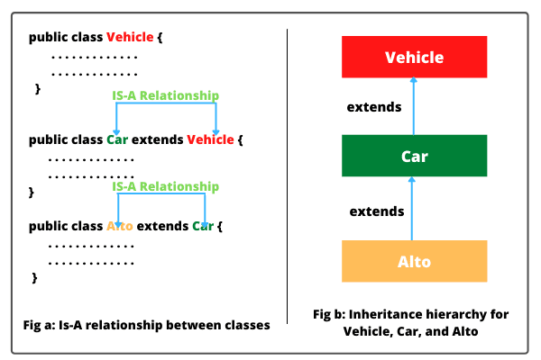
What is inheritance ?
Typically, the subclass exhibits the behaviors of its superclass and additional behaviors that are specific to the subclass.

Slide 7
Direct inheritance and indirect inheritance
A direct superclass is the super class from which the subclass explicitly inherits.
An indirect superclass is any class above the direct superclass in the class hierarchy, which defines the inheritance relationships between classes.
In fact, every class you define in Java is inherited from an existing class, either explicitly or implicitly.
All the classes that we created were all extended implicitly from (java.lang.Object).

Slide 8
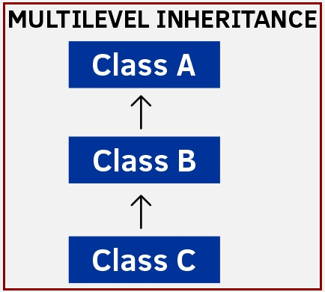
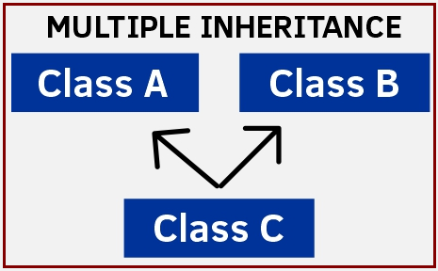
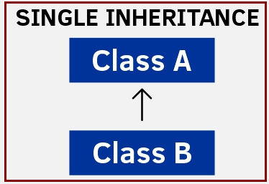
Single and multiple inheritance
When a subclass is derived from one direct superclass it is called single inheritance.
When a subclass is derived from more than one direct superclass it is called
Multiple inheritance. Note: Java, unlike C++, does not support multiple inheritance.

Slide 9
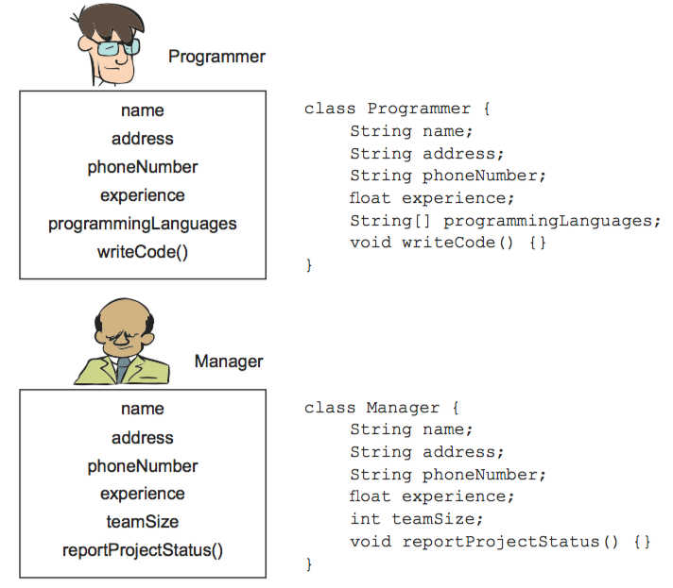
Inheritance Example
Imagine the positions Programmer and Manager within an organization.
Both positions have a common set of properties, including name, address, and phone number.
These positions also have different properties.
A Programmer may be concerned with a project’s programming languages, whereas a Manager may be concerned with project status reports.

Slide 10
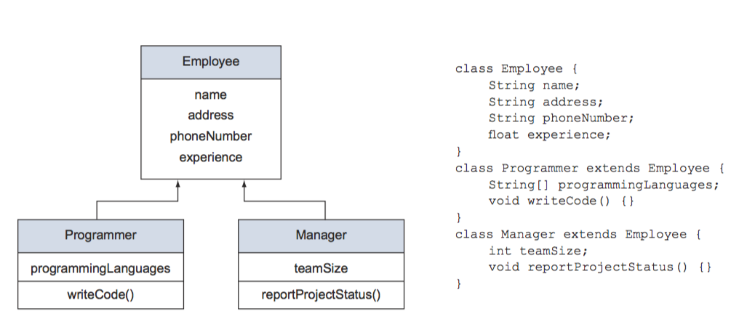
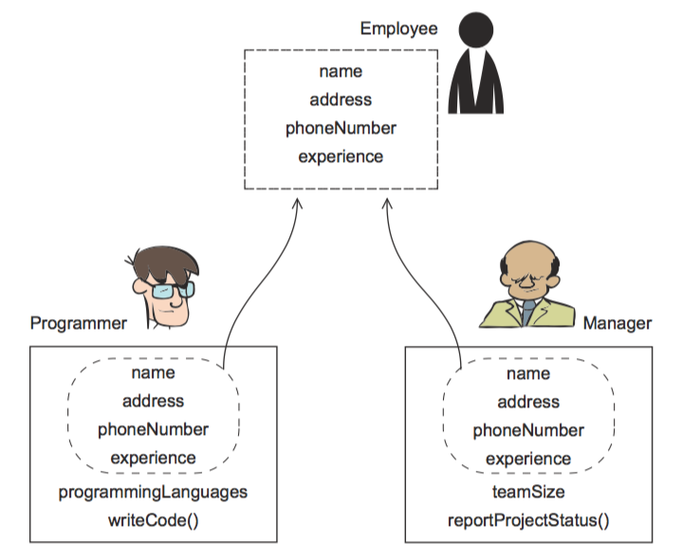
Inheritance Example
Put the common information in a base(general) class:

Slide 11
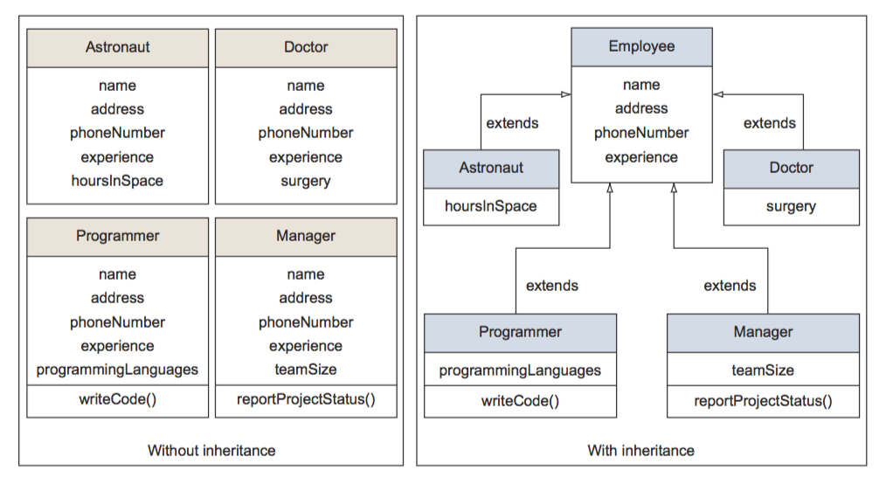
Inheritance Benefits
Less code redundancy:
Common list of attributes among all subclasses

Slide 12
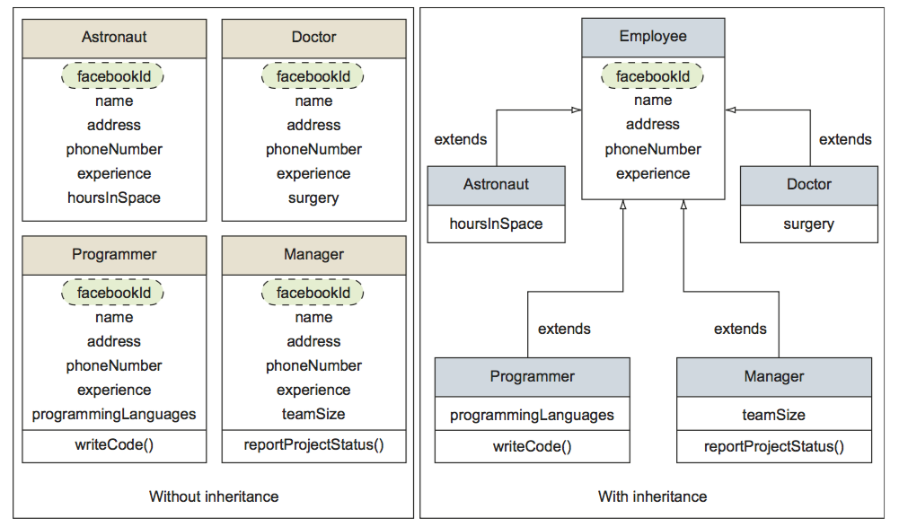
Inheritance Benefits
Ease of Modification: Suppose you need to add new attribute (facebookid).

Slide 13
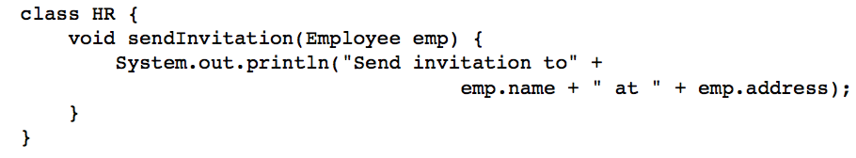
Inheritance Benefits
Extensibility: Code that works with the base class in a hierarchy tree can work with all classes that are added using inheritance later.
Assume that an organization needs to send out invitations to all its employees and that it uses the following method to do so:

Slide 14
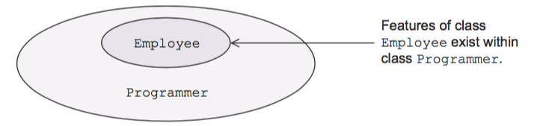
Inheritance Benefits
Because the method sendInvitation accepts an argument of type Employee, you can also pass to it a subclass of Employee. Essentially, this design means that you can use the previous method with a class defined later that has Employee as its base class. Inheritance makes code extensible.

Slide 15
Inheritance (Design Phase)
superclass Name
Common List of Attributes …
Superclass
Template
Common List of methods…
Extends
Extends
Extends
subclass₁ Name
Specific List of Attributes
subclass₂ Name
Specific List of Attributes
subclass_{n} Name
Specific List of Attributes …
Subclasses
Template
….
Level1
Specific List of methods..
Specific List of methods..
Specific List of methods..

Slide 16
Using The Keyword extends
The keyword extends is used for inheritance.
Examples:
class Car extends Vehicle {….. }
//Car is subclass, while Vehicle is superclass
class Circle extends Shape {…. }
//Circle is subclass, while Shape is superclass

Slide 17
Inheritance Example (Design Phase)
Shape
- color: String
- name: String
+ setColor (String color): void
+ setName (String name): void
+ getColor (): String
+ getName (): String
+ toString(): String
Rectangle
length: int
width: int
+ area (): int
+ toString(): String

Slide 18
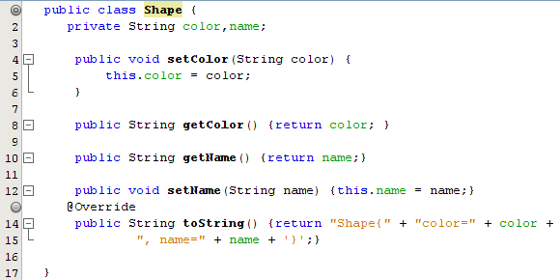
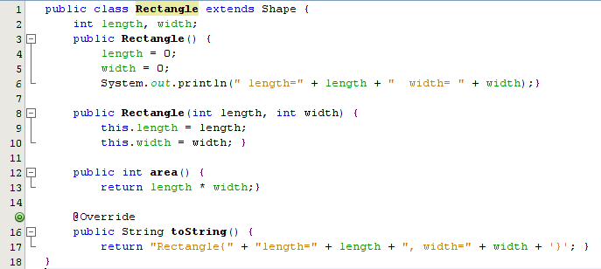
Inheritance Example (Implementation Phase)

Slide 19
Inheritance Example (explanation)
In the previous inheritance example code:
The Rectangle subclass can access all the public and protected members in the Shape class (superclass). On the contrary, the Shape superclass can access nothing from the Rectangle subclass.
The Shape superclass has two data fields (color and name) and five methods (setColor(), setName(), getColor (), getName(), and toString()).
The Rectangle subclass has four data fields (color, name, length, and width) and seven methods (all the superclass methods, area() and toString()).
The extends keyword indicates that a class is inherited from another class.

Slide 20
Inheritance Explanation
The following steps are taken by the Java compiler when creating an object from a superclass, a subclass, or both of them:
The process of creating an object from the superclass implements only the superclass constructor without invoking the subclass(es).
Creating an object from a subclass implicitly calls the no-argument constructor in the superclass first and then implements the used constructor in the subclass.
If the superclass doesn't have a no-argument constructor and only has constructors with arguments, then the subclass constructor must explicitly call one of the superclass constructors.

Slide 21
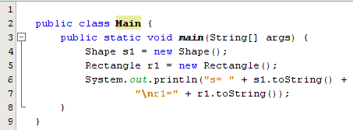
Inheritance Example of (main class)
Creating an object from the superclass (Shape) in line 4 should only implements the required constructor (Note that there is no zero constructor in the Shape class, so the default constructor will be invoked).
Creating an object from the subclass (Rectangle) in line 5 should implement the constructor without parameters in the Rectangle class in line3. But before that, the default constructor in the (Shape) class should be invoked to provide the default values for the data fields of the superclass, and then complete implementing the constructor in line 3.

Slide 22
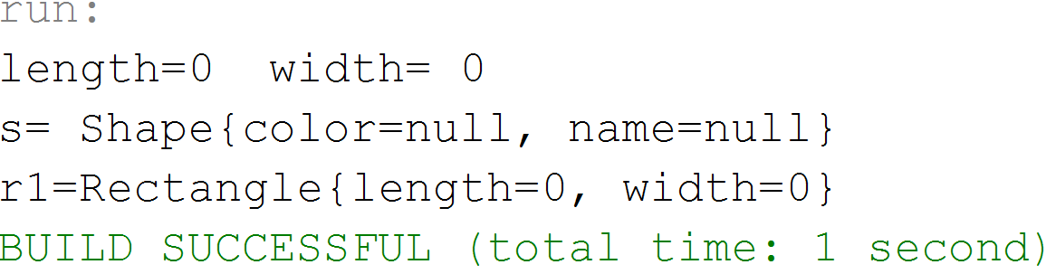
Inheritance Example of (main class)
S1
r1
color : null
name: null
color: null
name: null
length: 0
width: 0
Output:
These values are filled by contacting the superclass's default constructor (since there are no constructors in the superclass) as a first step before implementing the required constructor (Rectangle()) in the subclass (Rectangle class).

Slide 23
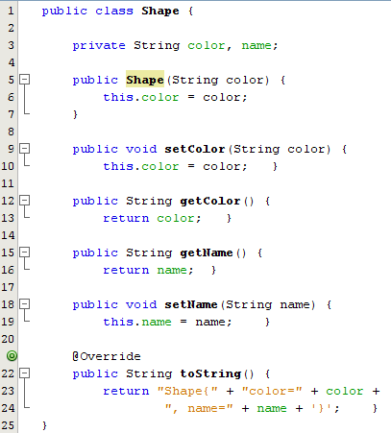
Inheritance (Constructors)
But what if we add the following constructor to
the class (Shape) ???
Followed up in the next slide

Slide 24
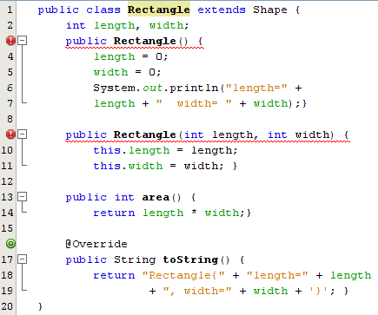
Inheritance (Constructors)
Lots of errors occurred in the subclass (Rectangle):
In this case error messages appear in all the constructors in the subclass saying (cannot find constructor Shape()). This is because the default constructor in the superclass has no longer existed and there is no constructor without parameters in the superclass. To solve this problem, We have two ways, and we will explain each of them in detail….

Slide 25
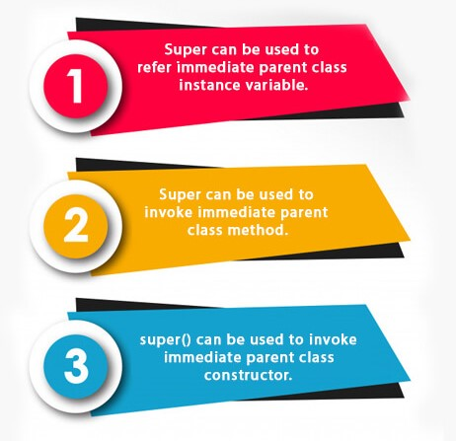
Using the keyword super
The keyword super refers to the superclass of the class in which super appears. This keyword can be used in three ways:
To call a superclass instance variables.
To call a superclass methods.
To call a superclass constructors.
The syntax of the (super) to call a superclass construct is:
super(), or super(parameter list) just like this( ) keyword, super should be written as the first statement in the constructor.

Slide 26
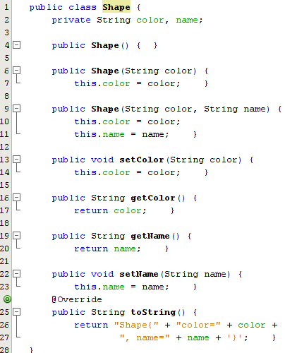
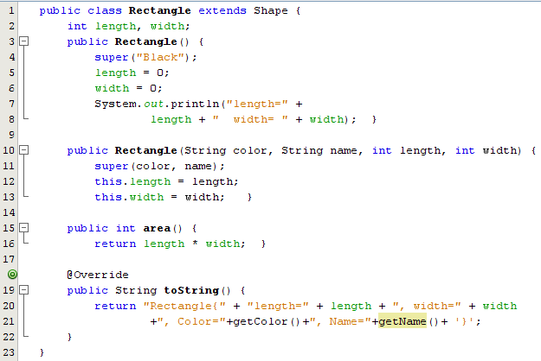
Using the keyword super to invoke superclass constructor

Slide 27
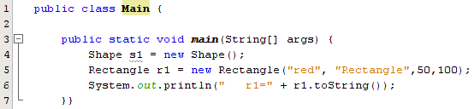
Using the keyword super
As shown in Main class,
The process of creating (r1) using the constructor with 4 parameters (line 10) requires calling the constructor with 2 parameters in the superclass (line 9), passing the actual values ("red", "Rectangle") to it.

Slide 28
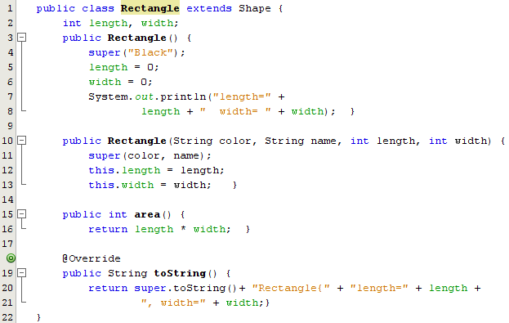
Inheritance – Calling superclass methods
To invoke a method in the superclass. The code of the (toString) method in the subclass could be written as follows:
The (super.toString()) implements the superclass’s (toString) method and the returned value added to the implementation of the rest of the string.

Slide 29
Inheritance main class
Output:

Slide 30
Are superclass’s Constructor Inherited?
No. They are not inherited,they are invoked explicitly or implicitly.
Explicitly using the super keyword.
A constructor is used to construct an instance of a class.
Unlike properties and methods, a superclass's constructors are not inherited in the subclass.
They can only be invoked from the subclasses' constructors, using the keyword super.
If the keyword super is not explicitly used, the superclass's no-arg constructor is automatically invoked.

Slide 31
Constructor Chaining
class Point { Point(){ System.out.print("Point Constructor ==> " ); }}
class Cylinder extends Circle {
public Cylinder(){ System.out.print("Cylinder Constructor." ); } }
class Circle extends Point{
public Circle(){
System.out.print("Circle Constructor ==> " ); } }
class Project { public static void main(String[] args) { Cylinder ob = new Cylinder(); }}
Output:
Point Constructor ==> Circle Constructor ==> Cylinder Constructor.

Slide 32
Constructor Chaining (Code Tracing)
1
An object of type Cylinder is created using the empty constructor
class Project { public static void main(String[] args) { Cylinder obj = new Cylinder(); } }

Slide 33
Constructor Chaining (Code Tracing)
2
class Point { Point(){
System.out.print("Point Constructor ==> " );
}}
The output statement of the Point class in the empty constructer is executed
Output:
Point Constructor ==>

Slide 34
Constructor Chaining (Code Tracing)
3
class Circle extends Point{
public Circle(){
System.out.print("Circle Constructor ==> " );
} }
The output statement of the Circle class in the empty constructer is executed
Output:
Point Constructor ==> Circle Constructor ==>

Slide 35
Constructor Chaining (Code Tracing)
4
class Cylinder extends Circle {
public Cylinder(){
System.out.print(“Cylinder Constructor ==> " );
} }
The output statement of the Cylinder class in the empty constructer is executed
Output:
Point Constructor ==> Circle Constructor ==> Cylinder Constructor.

Slide 36
The protected Modifier
The protected modifier can be applied on data and methods in a class. A protected data or a protected method in a public class can be accessed by any class in the same package or its subclasses, even if the subclasses are in a different package.
Access modifiers: private, default, protected and public.

Slide 37
Access Modifiers Summary

Slide 38
Access Modifiers Summary

Slide 39
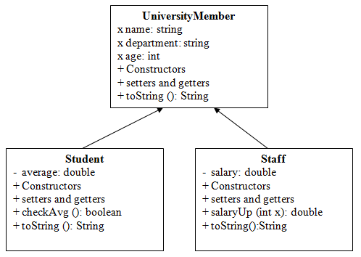
Exercise: Design the following classes and write the given methods:
salaryUp(int x):It takes an int number as input to indicate the increase in pay and computes salary as follows:
Salary = salary + x
checkAvg(): that returns true if the average is greater than or equal to 50, otherwise, it returns false.

Slide 40
Examples of possible inheritance relationship between different classes
Superclass | Subclasses
Student | GraduateStudent, UndergraduateStudent
Shape | Circle, Triangle, Rectangle
Loan | CarLoan, HomeImprovementLoan, MortgageLoan
Employee | Faculty, Staff
BankAccount | CheckingAccount, SavingsAccount

Slide 41
Overriding & Overloading methods
A subclass inherits methods from superclass. Sometimes it is necessary for the subclass to modify the implementation of a method defined in the superclass. This is referred to as method overriding.
The (toString) method is an example of overriding in the previous examples. The signature of the overridden methods should be exactly the same but in different classes.
On the other hand, overloading is the reuse of the method name in the same class but with different signature to distinguish between them. Constructors are an example of overloading.

Slide 42
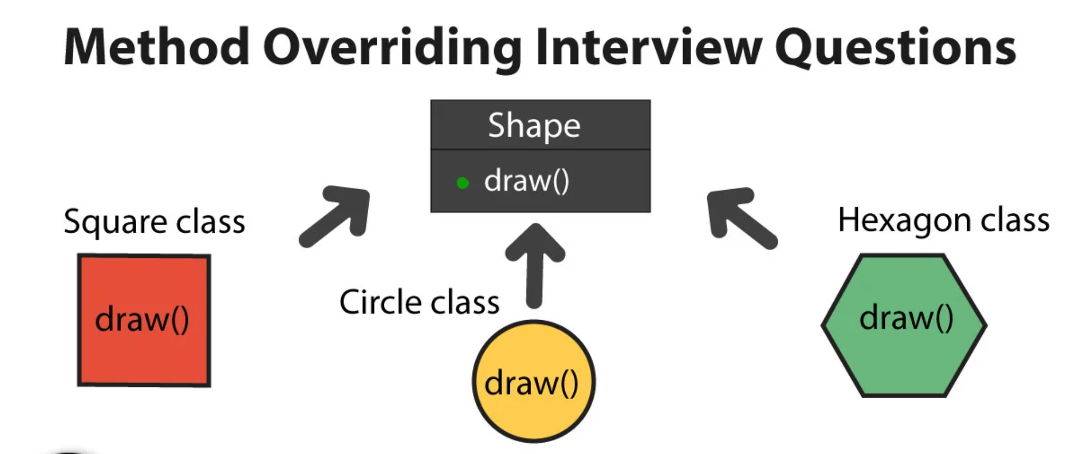
Overriding & Overloading methods
JAVA Programming

Slide 43
Overriding & Overloading methods
Overloading | Overriding
Must have at least two methods by the same name in the same class | Must have at least one method by the same name in both superclass and subclass
Must have a different number of parameters | Must have the same number of parameters
If the number of parameters is the same then must have different types of parameters | The type of parameters also must be the same
If the number and type of parameters are the same then must have different orders of parameters | The order of parameters also must be the same
Constructors are an example of overloading | The (toString) method is an example of overriding
Overloadingis known as a static polymorphism | Overriding is known as a dynamic polymorphism

Slide 44
The Object Class and Its Methods
Every class in Java is descended from the java.lang.Object class. If no inheritance is specified when a class is defined, the superclass of the class is Object.
Note: Object class acts as a root of inheritance hierarchy in any java program.

Slide 45
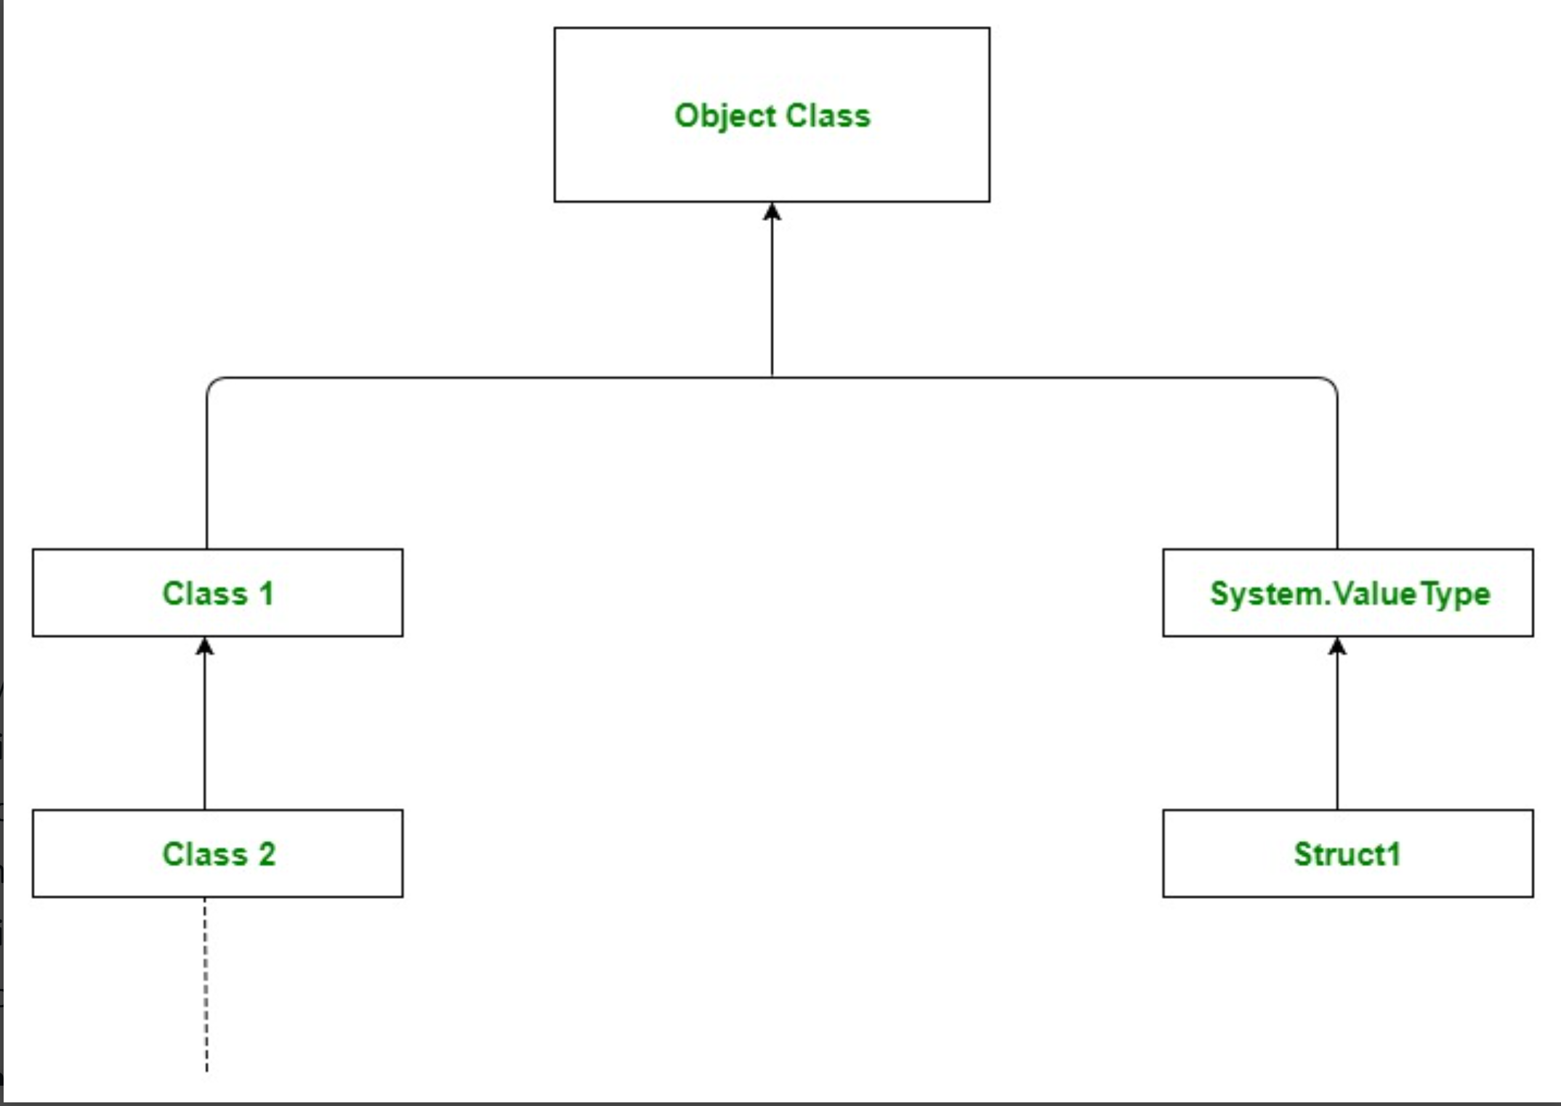
The Object Class and Its Methods

Slide 46
The toString() method in Object
The toString() method returns a string representation of the object.
Note: Default behavior of toString() is to print class name, then @, then unsigned hexadecimal representation of the hash code of the object.
Example :
The code displays something like Loan@15037e5 . This message is not very helpful or informative. Usually you should override the toString method so that it returns a digestible string representation of the object.
Loan loan = new Loan(); System.out.println(loan.toString());

Slide 47
The equals() Method
The equals() method compares the contents of two objects. The default implementation of the equals method in the Object class is as follows:
For example, the equals method is overridden in the Rectangle class.
public boolean equals(Object obj) {
return this == obj;
}
public boolean equals(Rectangle obj) {
return (this.width==obj.width) &&
(this.length==obj.length);
}

Slide 48
NOTE
The == comparison operator is used for comparing two primitive data type values or for determining whether two objects have the same references.
The equals method is intended to test whether two objects have the same contents, provided that the method is modified in the defining class of the objects.
The == operator is stronger than the equals method, in that the == operator checks whether the two reference variables refer to the same object.

Slide 49
The final Modifier
The final class cannot be extended:
final class Math {
...
}
The final variable is a constant:
final static double PI = 3.14159;
The final method cannot be overridden by its subclasses.

Slide 50
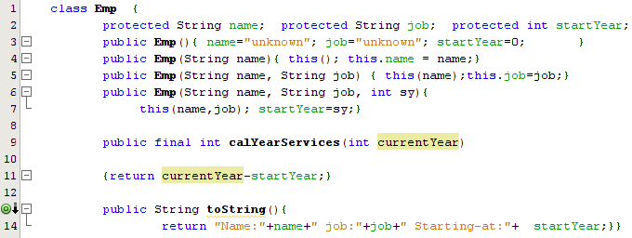
The final Method
When a method is defined as "final," this means it cannot be overridden.

Slide 51
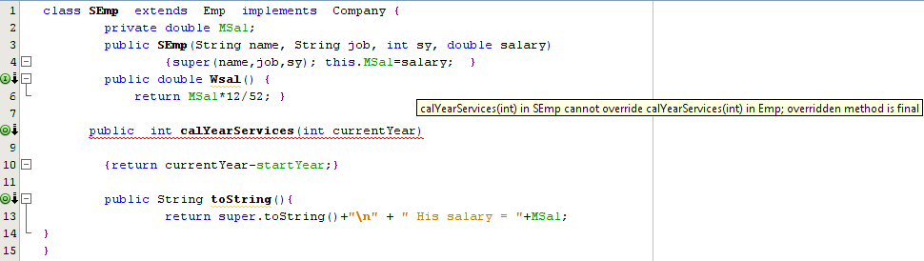
The final Method error message

Slide 52
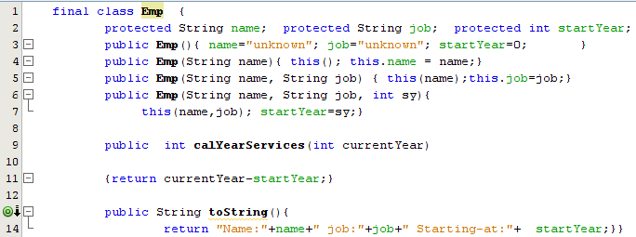
The final Class
When a class is defined as "final," this means it cannot be inherited.

Slide 53
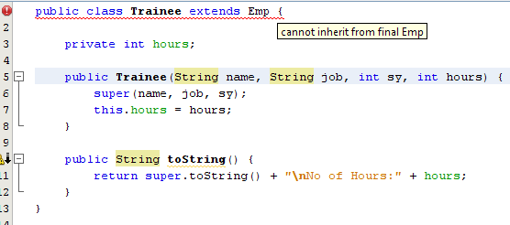
The final Class error message

Slide 54
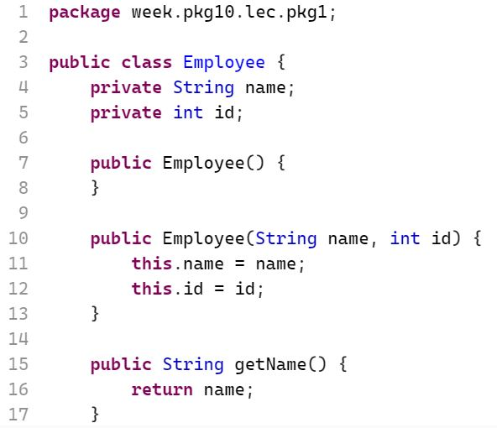
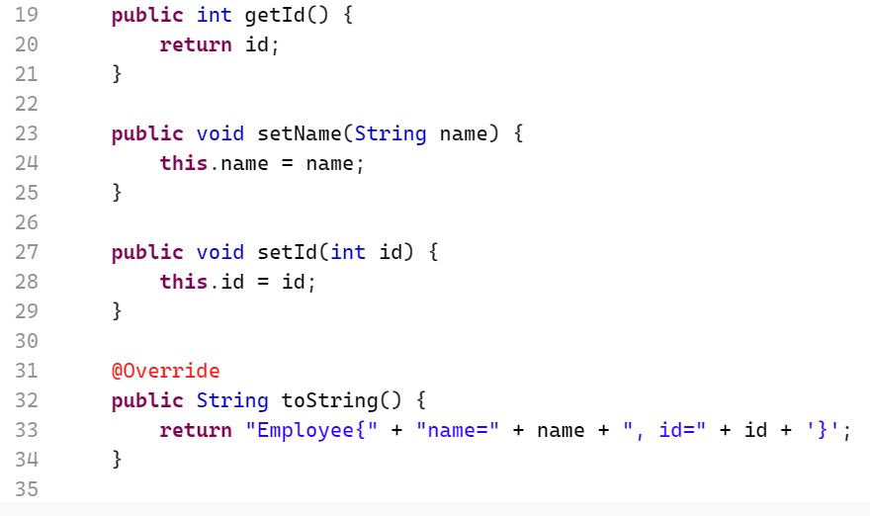
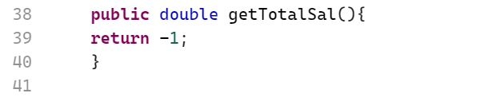
Inheritance Example

Slide 55
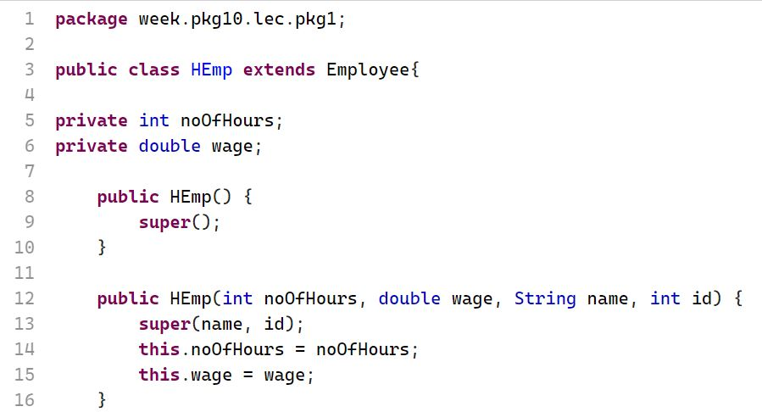
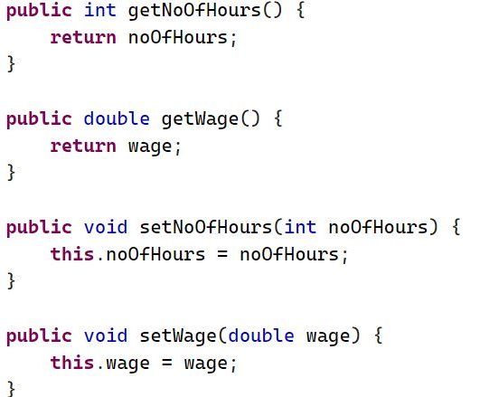
Inheritance Example

Slide 56
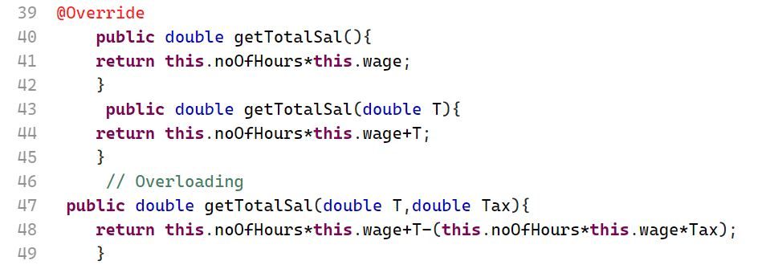
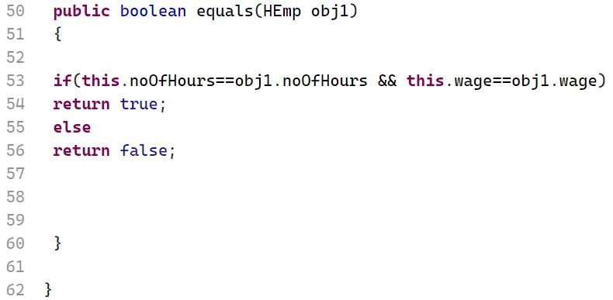
Inheritance Example

Slide 57
Exercise (part 1)
Using Java, Design and implement a class hierarchy to model different types of documents. Create a superclass named Document that encapsulates common attributes of all types of documents. Additionally, create a subclass named Book.
The superclass Document should include the following:
A protected instance variable authorName of type String.
Two private instance variables; numberOfPages of type int and classificationNo of type String.
A parameterized constructor to initialize the instance variables.
Appropriate getter and setter methods for the numberOfPages and classificationNo variables. The classificationNo attribute must start with the letter H or S (where H stands for hard copy documents and S for softcopy documents) followed by four digits such as "H1345", "S8756". Otherwise, you should display an error message (Invalid classification number).
An instance method named display that prints all relevant details of the Document.

Slide 58
Exercise (part 2)
The subclass Book should inherit the instance variables and methods of the Document class. It should include the following:
Private instance variables for the book: subject of type String and yearOfPublishing of type int.
A parameterized constructor to initialize the instance variables.
Override the display method to display all details of the book.
An instance method called checkYear that checks if the book is published after a given year. The method should return true if it is published after or the same given year, and false otherwise.
Override the equals method to compare two books based on their subject. The method should return true if the subjects are the same, and false otherwise.

Slide 59
Exercise (part 3)
Implement a test class (main method only) that performs the following:
Create two objects of type book with appropriate initial values of your choice.
Call the display method for both objects.
Check if the first object is equal to the second object. If the first object is equal to the second object, print "Equal“, otherwise, print "Not Equal".
Check and print the result of calling checkYear for both books objects with a year 2019.

Slide 60
References
[1] Introduction to Java Programming, Comprehensive Version, Student Value Edition, Daniel Liang, 12th Edition, Pearson 2019
lecture Notes: edugate.asu.edu.jo.
lecture Videos: YouTube channel.
Lab manual

